Slide 1
PDF CONTENT LABELING
Submitted by
K. Vishnu Goutham

Slide 2
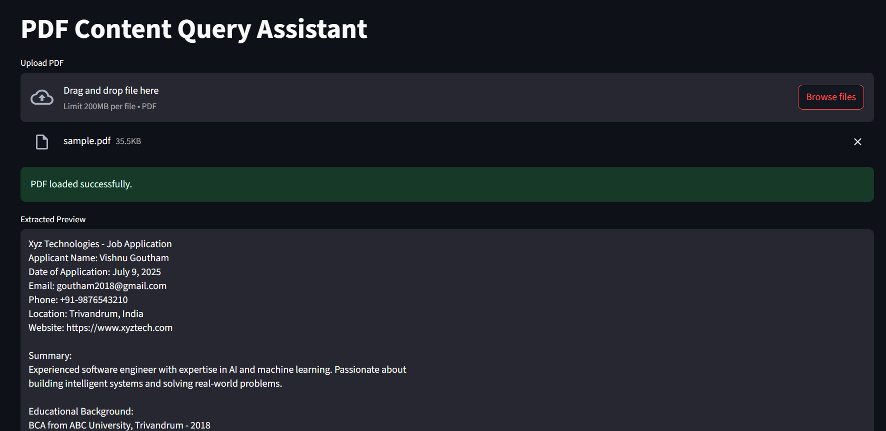
OBJECTIVE
Automatically extract and label key information from PDF files.
Enable users to query the content using natural language questions.
Combine rule-based logic, NLP (spaCy), and regex to ensure reliable extraction.

Slide 3
FUNCTIONALITY
How it works:
Upload any PDF
Text is extracted using PyMuPDF
spaCy is used for Named Entity Recognition
Regex handles fallback for phones, emails, etc.
Streamlit interface for asking questions
Stores Q&A history, supports CSV export

